Slide 1
Quick recap

Slide 2
Population mean and variance
How can we think of the population mean of a random variable?
The population mean is the
long run average
value of a random variable.
So if we played the lottery again, and again, and again, infinitely many times, the average amount we win in the long run is -$1.20.
In an experiment with binomially distributed outcomes and parameters n and p, the long-run average number of successes is n*p.

Slide 3
Population mean and variance
How can we think of the population variance of a random variable?
The population variance is the
long run variance
value of a random variable.

Slide 4
Adding means and variances
Suppose that the graduate student’s experimental runs are independent, and the probability of success on the first experiment was 0.75, the probability of success on the second experiment was 0.75, and the probability of success on the third experiment was 0.75.
What's the long run mean number of successes?

Slide 5
Adding means and variances
Suppose that the graduate student’s experimental runs are independent, and the probability of success on the first experiment was 0.75, the probability of success on the second experiment was 0.75, and the probability of success on the third experiment was 0.75.
What's the long run mean number of successes?
Mean # successes over 3 experiments
= mean number of successes in 1st experiment +
mean number of successes in 2nd experiment +
mean number of successes in 3st experiment
= 0.75 + 0.75 + 0.75
= 2.25

Slide 6
Adding means and variances
Suppose that the graduate student’s experimental runs are independent, and the probability of success on the first experiment was 0.75, the probability of success on the second experiment was 0.75, and the probability of success on the third experiment was 0.75.
What's the long run mean number of successes?
Mean # successes over 3 experiments
= mean number of successes in 1st experiment +
mean number of successes in 2nd experiment +
mean number of successes in 3st experiment
= 0.75 + 0.75 + 0.75
= 2.25
Assumes that experiments are independent!

Slide 7
Quiz: Adding means and variances
Suppose that the graduate student’s experimental runs were still independent, but the probability of success on the first experiment was 0.2, the probability of success on the second experiment was 0.5, and the probability of success on the third experiment was 0.9.
What is the long-run mean # successes?

Slide 8
Quiz: Adding means and variances
Suppose that the graduate student’s experimental runs were still independent, but the probability of success on the first experiment was 0.2, the probability of success on the second experiment was 0.5, and the probability of success on the third experiment was 0.9.
Long-run mean # successes
= 0.2 + 0.5 + 0.9
= 1.6
This means that if we took the average over lots and lots of graduate students with these success probabilities, the average number of successes over all graduate students would be 1.6

Slide 9
Probability Distributions
II

Slide 10
Multinomial Distribution
The Binomial distribution was a great model for cases where we have independent trials and 2 possibilities: success and failure
What about when we have 3 different categories?
4 different categories?
20 different categories?
The multinomial distribution is a model for categorical data where we have multiple categories, independent runs and the same probabilities of observing each category.

Slide 11
Multinomial Distribution - Motivation
Consider a heterozygous allele for a recessive trait. We have 3 categories
Unaffected (AA)
Affected (aa)
Carrier (Aa)
If both parents are carriers, what’s the probability that of their 4 offspring
One will be unaffected, two will be affected and one will be a carrier?
All of their offspring will be carriers?
Two of their offspring will be affected and two will be carriers?

Slide 12
Multinomial Distribution - Motivation
Suppose we have J categories
Let Y_{i} be the number of times we observe category i
For example, let
i = 1 refer to unaffected (AA)
i = 2 refer to carrier (Aa)
i = 3 refer to affected (aa)
Then
“0 unaffected, 3 carriers, 1 affected,”
corresponds to
Y₁ = 0, Y₂ = 3, Y₃ = 1

Slide 13
Multinomial Probabilities
What is the probability that a multinomial random variable with n trials and success probabilities p₁, p₂, …, p_{J} will yield exactly k₁, k₂,…k_{J} successes?

Slide 14
Multinomial Probabilities
Assumptions:
1) J possible outcomes in a given trial.
2) The probability of each category p_{j}, is the same from trial to trial.
3) The outcome of one trial has no influence on other trials (independent trials).
4) Interest is in the (sum) total number of “successes” over all the trials.
k₁ k₂ k₃ k₄
k_{J-1} k_{J}
n = Σ_{j} k_{j} is the total number of trials.

Slide 15
Multinomial Probabilities - Examples
Returning to the original questions:
Q₁: Of n=4 offspring, one will be unaffected, two will be affected and one will be a carrier?
Solution: For a given child, the probabilities of the three outcomes are:
p₁ = Pr[AA] = 1/4, p₂ = Pr[Aa] = 1/2, p₃ = Pr[aa] = 1/4.
We have

Slide 16
Quiz
Suppose the couple decided they wanted 3 children
What is the probability that all three offspring will be carriers?
What is the probability that exactly two offspring will be affected and one a carrier?

Slide 17
Solutions
Q₂: What is the probability that all three offspring will be carriers?
Q₃: What is the probability that exactly two offspring will be affected and one a carrier?

Slide 18
Example - Mean and Variance
It turns out that the (marginal) outcomes of the multinomial distribution are binomial. We can immediately obtain the means for each outcome (i.e., the j^{th} cell) MEAN:
VARIANCE:
COVARIANCE:

Slide 19
Multinomial Distribution Summary
Multinomial
1. Discrete, bounded
2. Parameters - n, p₁, p₂,…,p_{J}
Sum of n independent outcomes
Extends binomial distribution
5. Polytomous regression, contingency tables

Slide 20
Continuous Distributions

Slide 21
Continuous Distributions
For measurements like height and weight which can be measured with arbitrary precision, it does not make sense to talk about the probability of any single value. Instead we talk about the probability for an interval.
P[weight = 70.000kg] ≈ 0
P[69.0kg < weight < 71.0kg] = 0.08
For discrete random variables we had a probability mass function to give us the probability of each possible value. For continuous random variables we use a probability density function to tell us about the probability of obtaining a value within some interval.

Slide 22
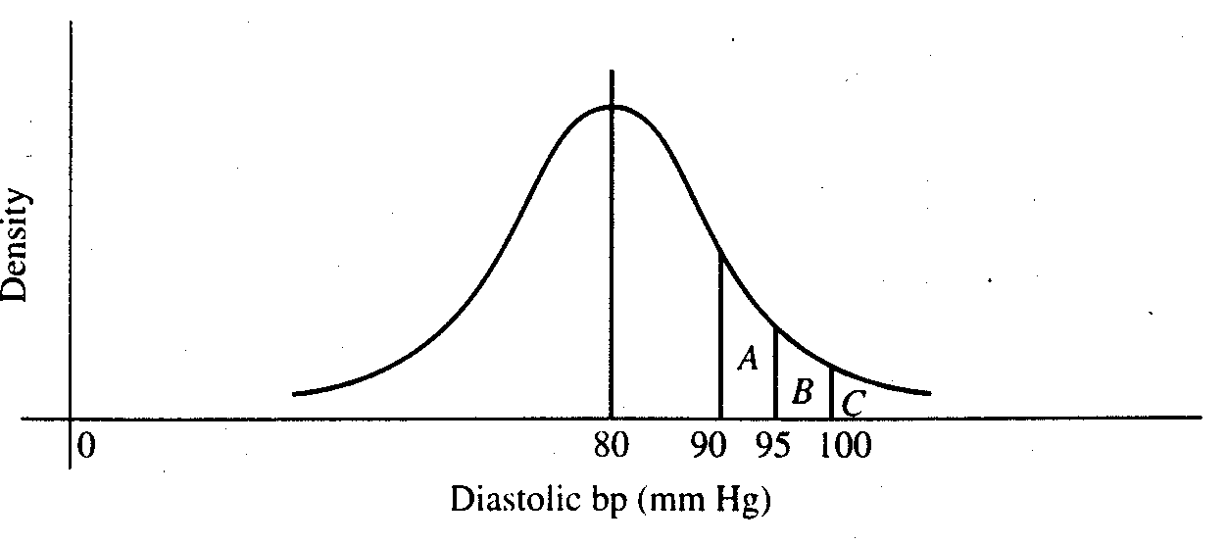
With discrete probability distributions, we can determine the probability of a single outcome, e.g.:
With continuous probability distributions, we can determine the probability across a range of outcomes:
For any interval, the area under the curve represents the probability of obtaining a value in that interval.

Slide 23
Probability density function
1. A function, typically denoted f(x), that gives probabilities based on the area under the curve.
2. f(x) > 0
3. Total area under the function f(x) is 1.0.
Cumulative distribution function
The cumulative distribution function, F(t), tells us the total probability less than some value t.
F(t) = P(X < t)
This is analogous to the cumulative relative frequency.

Slide 24
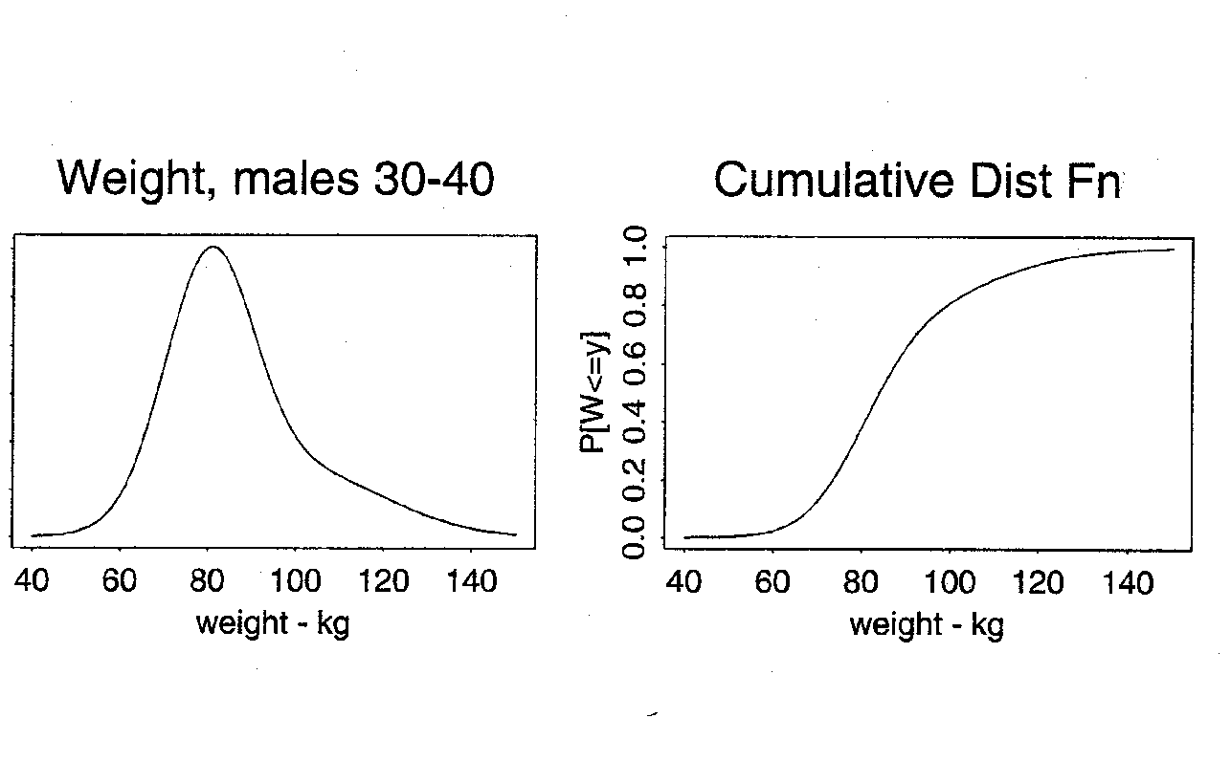
Prob[wgt < 80]
Area under the curve
= 0.40

Slide 25
Normal Distribution
A common probability model for continuous data
Bell-shaped curve
takes values between -∞ and + ∞
symmetric about mean
mean=median=mode
Examples (common but questionable!)
birthweights
blood pressure
CD4 cell counts (perhaps transformed)
The normal distribution is more useful
as a derived distribution,
as we will see when we talk about the
central limit theorem…

Slide 26
Normal Distribution
Specifying the mean and variance of a normal distribution completely determines the probability distribution function and, therefore, all probabilities.
The normal probability density function is:
where
π ≈ 3.14 (a constant)
Notice that the normal distribution has two parameters:
μ = the mean of X
σ = the standard deviation of X
We write X~N(μ , σ²). The standard normal distribution is a special case where μ = 0 and σ = 1.

Slide 27
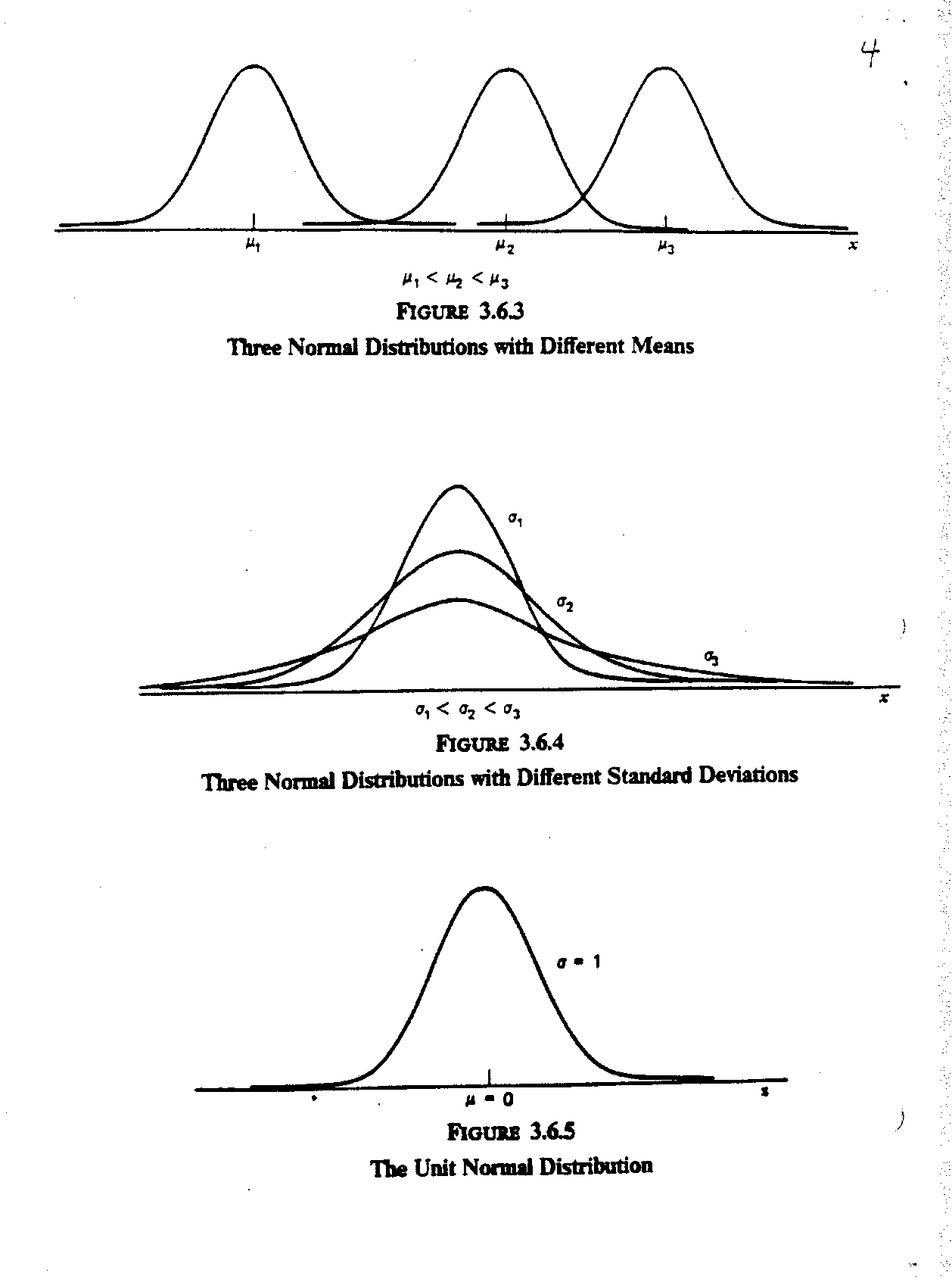

Slide 28
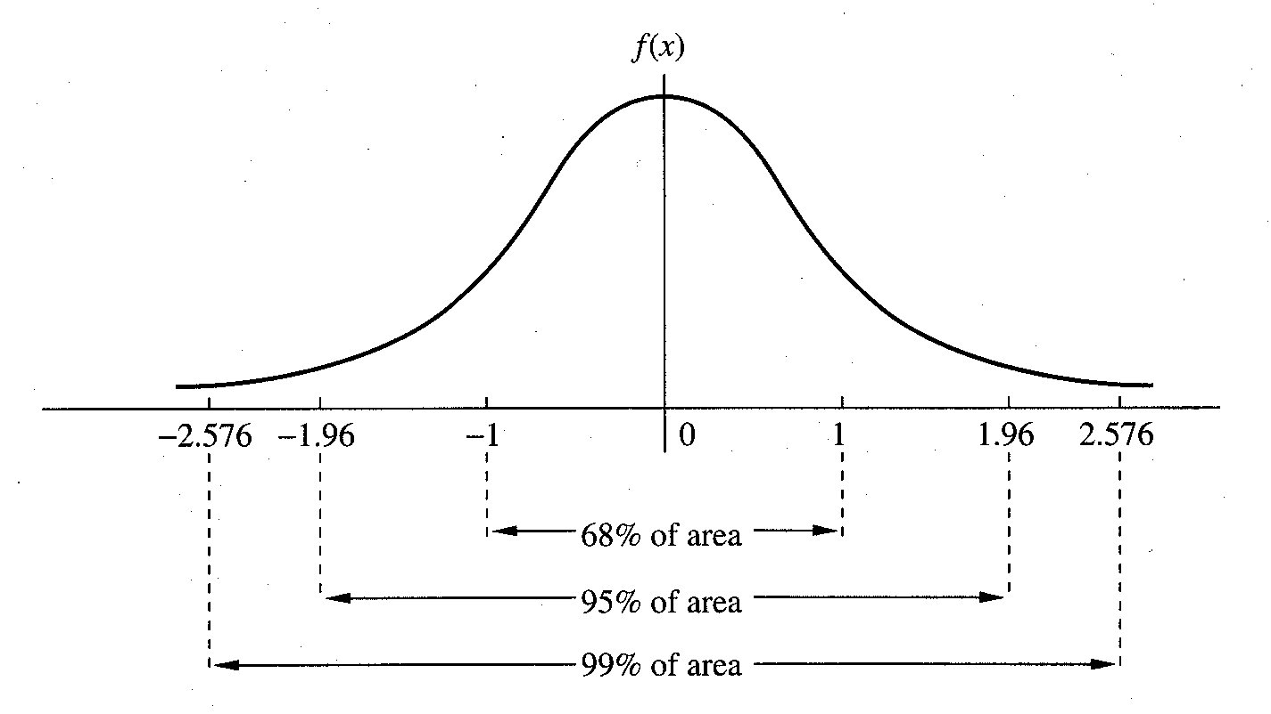

Slide 29
Normal Distribution - Calculating Probabilities
Example: Rosner 5.20
Serum cholesterol is approximately normally distributed with mean 219 mg/mL and standard deviation 50 mg/mL. If the clinically desirable range is < 200 mg/mL, then what proportion of the population falls in this range?
X = serum cholesterol in an individual.
μ =
σ =
negative values for cholesterol - huh?

Slide 30
Standard Normal Distribution - Calculating Probabilities
First, let’s consider the standard normal - N(0,1). We will usually use Z to denote a random variable with a standard normal distribution. The density of Z is
and the cumulative distribution of Z is:
Any computing software can give you the values of f(z) and Φ(z)

Slide 31
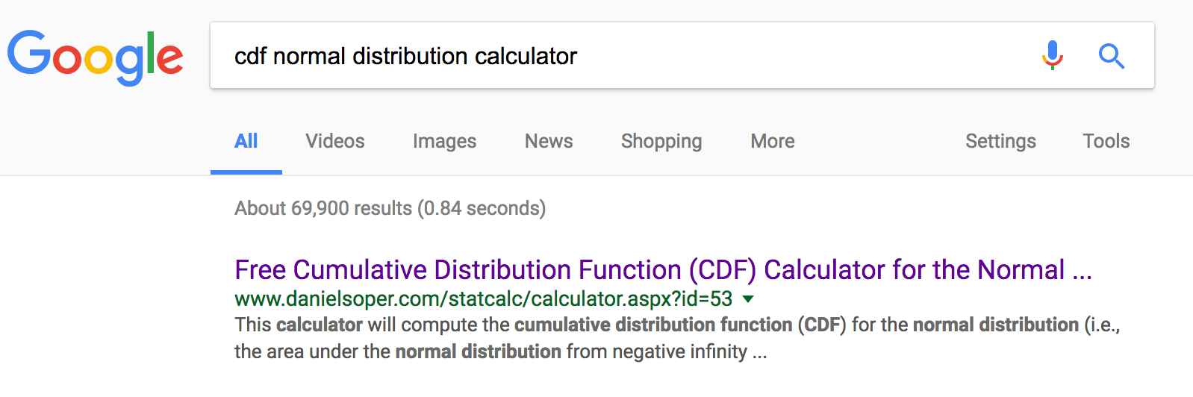
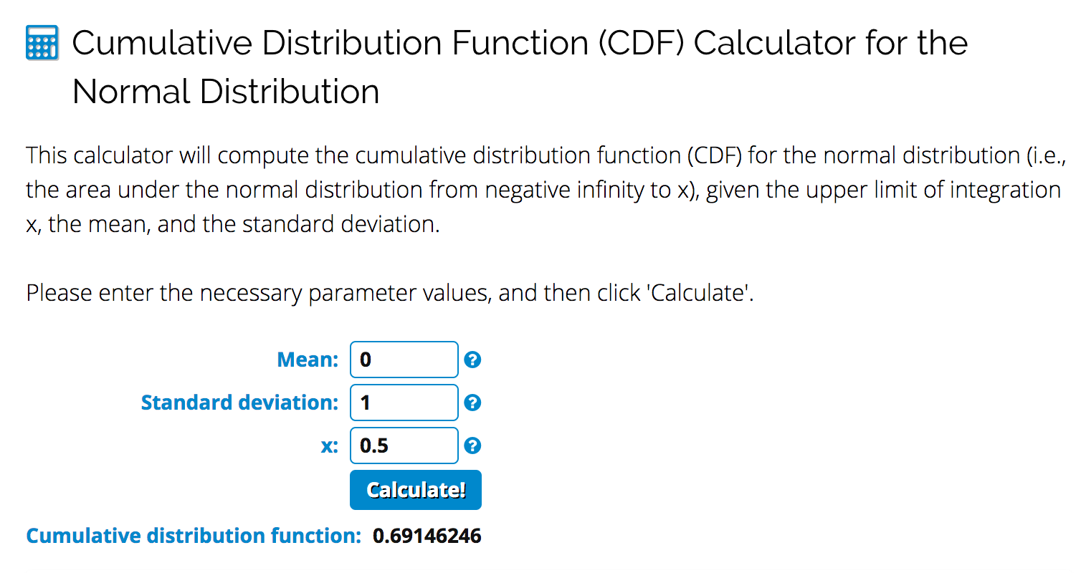
Standard Normal Distribution - Calculating Probabilities

Slide 32
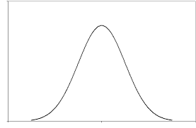
Facts about probability distributions
P[Z < z] = a
P[Z > z] = 1-a
P[Z < x] = b, P[Z < y] = c
Pr[x < Z < y ] = c-b
a
1-a
c
b
c-b

Slide 33
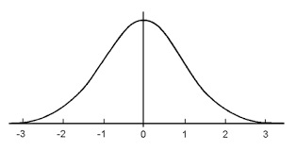
Facts about the standard normal distribution
Because the N(0,1) distribution is symmetric around 0,
Pr[Z < -y] = Pr[Z > y]
y
y

Slide 34
Quiz: 3 minutes
Google “cdf normal distribution calculator” and find the following if Z ~ N(0,1)
P[Z < 1.65] =
P[Z > 0.5] =
P[-1.96 < Z < 1.96] =
P[-0.5 < Z < 2.0] =

Slide 35
Solutions to Quiz
P[Z < 1.65] = 0.9505
P[Z > 0.5] = 1 – 0.6915 = 0.3085
P[-1.96 < Z < 1.96] = 0.975 – 0.025 = 0.95
P[-0.5 < Z < 2.0] = 0.9772 – 0.3085=0.6687

Slide 36
Converting to Standard Normal
This solves the problem for the N(0,1) case. Do we need a special table for every (μ,σ)?
No!
Define: X = μ + σZ where Z ~ N(0,1)
1. E(X) = μ + σE(Z) = μ
2. V(X) = σ²V(Z) = σ².
3. X is normally distributed!
Linear functions of normal RV’s are also normal.
If X ~ N (μ, σ²) and Y = aX + b
then
Y ~ N(aμ + b, a ²σ²)

Slide 37
Converting to Standard Normal
How can we convert a N(μ,σ²) to a standard normal?
Standardize:
What is the mean and variance of Z?
1. E(Z) = (1/ σ)E(X - μ) = 0
2. V(Z) = (1/ σ²)V(X) = 1

Slide 38
Normal Distribution - Calculating Probabilities
Return to cholesterol example (Rosner 5.20)
Serum cholesterol is approximately normally distributed with mean 219 mg/mL and standard deviation 50 mg/mL. If the clinically desirable range is < 200 mg/mL, then what proportion of the population falls in this range?
P( Z > 0.38)
= 0.3520.

Slide 39
Normal Approximation to Binomial
Example
Suppose the prevalence of HPV in women 18 -22 years old is 0.30. What is the probability that in a sample of 60 women from this population 9 or fewer would be infected?

Slide 40
Normal Approximation to Binomial
Example
Suppose the prevalence of HPV in women 18 -22 years old is 0.30. What is the probability that in a sample of 60 women from this population 9 or fewer would be infected?

Slide 41
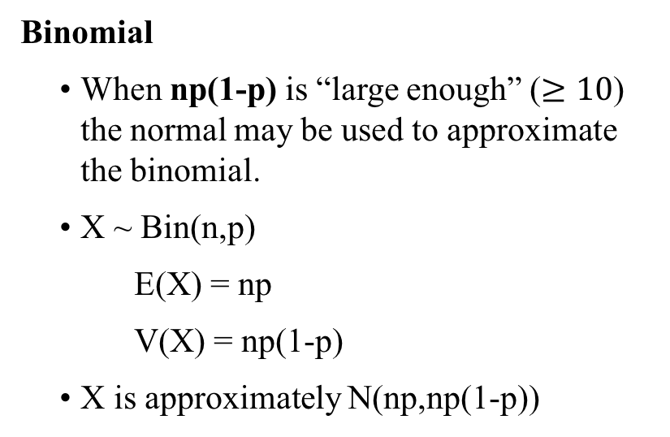
Normal Approximation to Binomial
Binomial
When np(1-p) is “large enough” ($≥10$) the normal may be used to approximate the binomial.
X ~ Bin(n,p)
E(X) = np
V(X) = np(1-p)
X is approximately N(np,np(1-p))

Slide 42
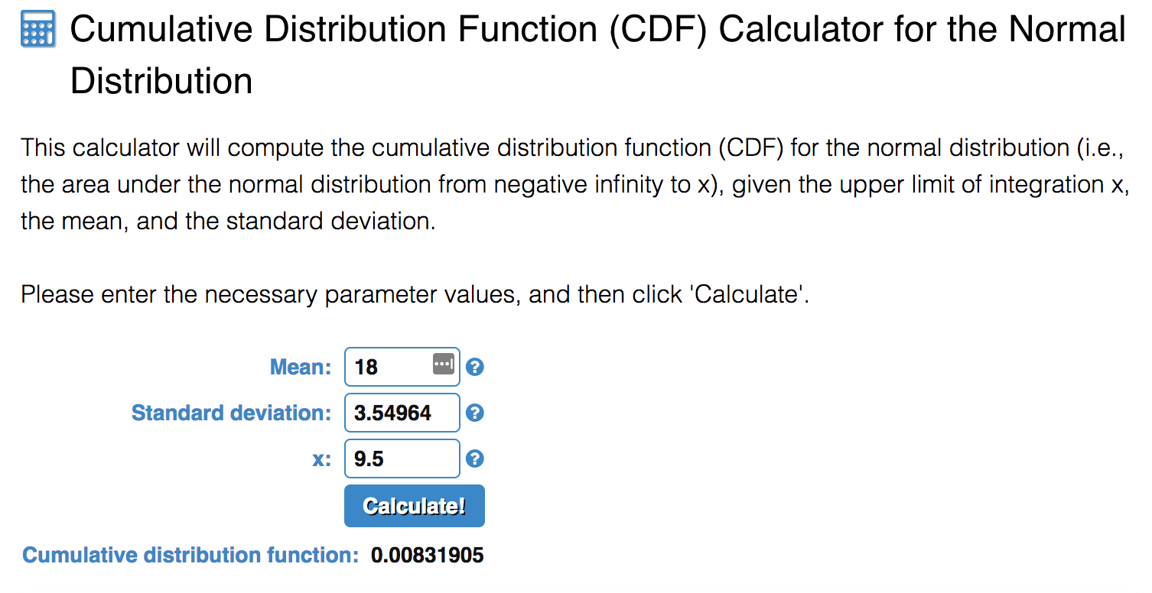
Normal Approximation to Binomial
Example
Suppose the prevalence of HPV in women 18 -22 years old is 0.30. What is the probability that in a sample of 60 women from this population that 9 or less would be infected?
Solution
X = number infected out of 60
X ~ Binomial(n=60, p =0.3)
X close to Normal distribution with mean 60*0.3=18 and variance 60*0.3*(1-0.3)=12.6

